Slide 1




C Introduction
& Basisc Syntax
Here is where your presentation begins

Slide 2


Table of contents
01
02
03
Introduction
Tool Setups
Syntax

Slide 3




Introduction

Slide 4


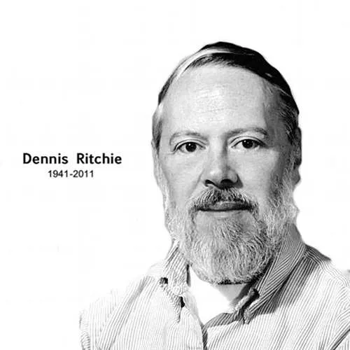


What is C?
C is a general-purpose programming language created by Dennis Ritchie in 1972. It is a very popular language, despite being old.

Slide 5


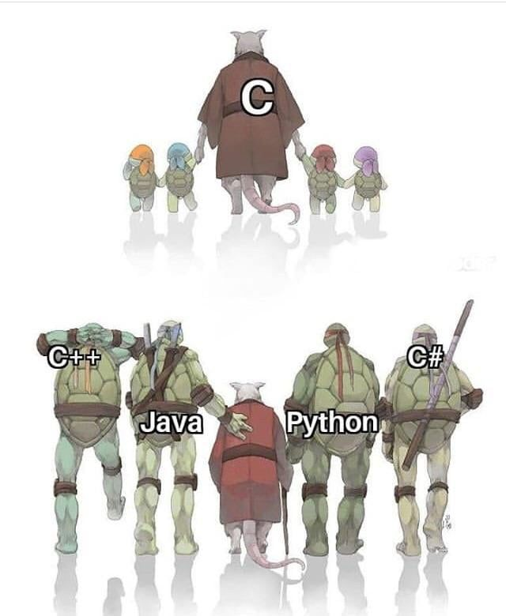

Why Learn C?
It is a fundamental language in the field of computer science. Knowing C, you will have no problem learning other popular programming languages such as Java, Python, C++, C#, etc, as the syntax is similar.
C is very fast, compared to other programming languages, like Java and Python
C is very versatile; it can be used in both applications and technologies
"syntax" refers to the set of rules that define the structure and order of symbols, keywords, and punctuation used to write valid code in a specific programming language

Slide 6



Tool Setups

Slide 7

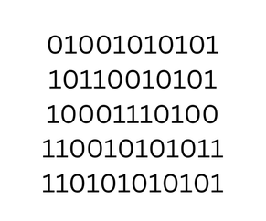
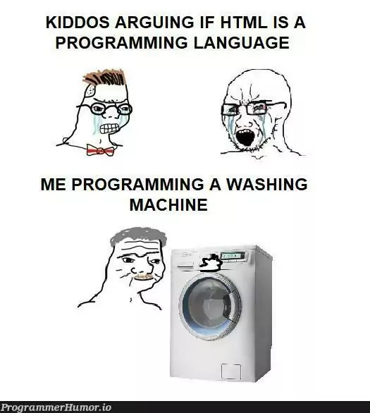

Programming language and Machine language
A "programming language" is a human-readable language used to write instructions (for a computer), while "machine language" is the low-level binary code that the computer directly understands, essentially the native language of the machine
; therefore, programmers typically write code in a higher-level language which is then translated into machine code to be executed by the computer.
Boombaya Boom
Computer
Human
*Sdab knea ot ban sbot
Using Programming Language
Using Machine Language

Slide 8


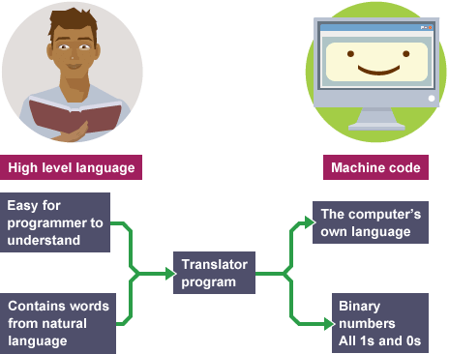

Compiler (aka Translator)
Make a proposal to my cr
A compiler is a software program that translates source code written in a high-level programming language (like C) into machine language, which is a low-level language that the computer can directly understand
GCC (GNU Compiler Collection) as a common and powerful compiler.

Slide 9
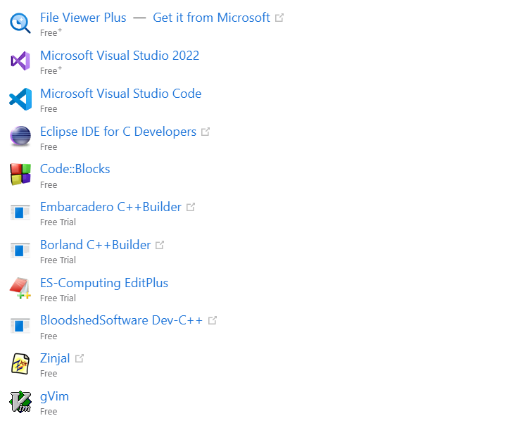

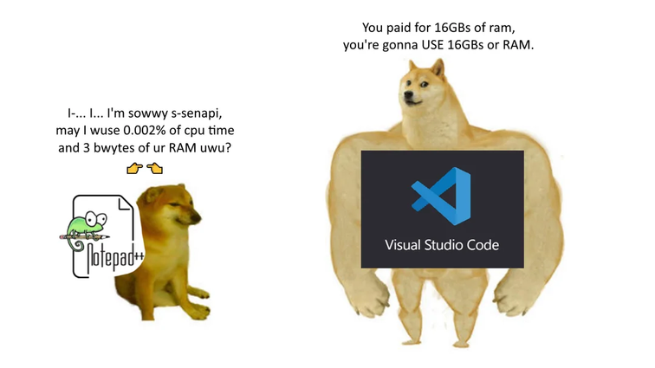

IDE (Integrated Development Environment)
Software that provides tools for writing, compiling, and debugging code. Mention Code::Blocks, Visual Studio, DevC++, ......
Visual Studio is chosen

Slide 10


Syntax

Slide 11

File Format
C program files, denoted by the . c extension, serve as containers for C programming language code

Slide 12


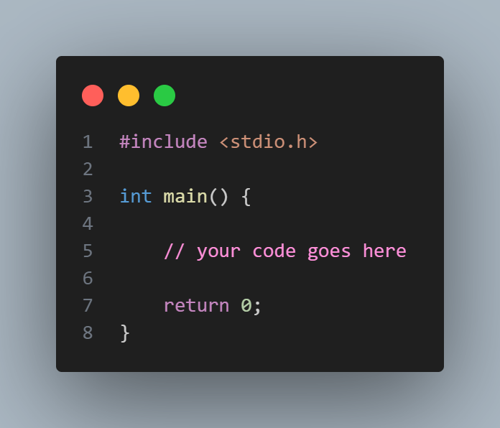

Syntax
Syntax in programming is the set of rules that define how to write computer code so that it can be understood by machines

Slide 13

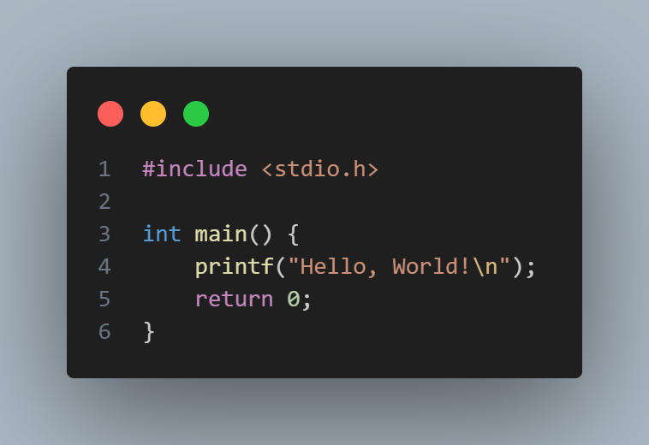


Example:
Output:

Slide 14



Thanks!

